Slide 1
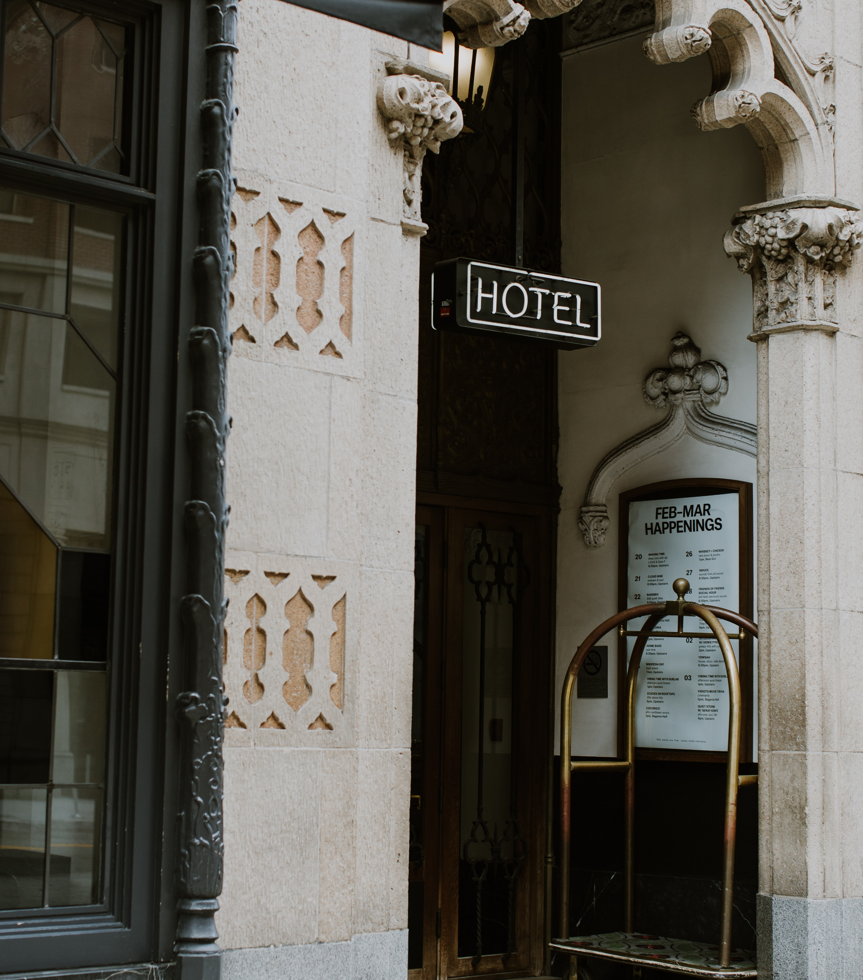

Predict Hotel Cancelation
Burak Arslan

Slide 2
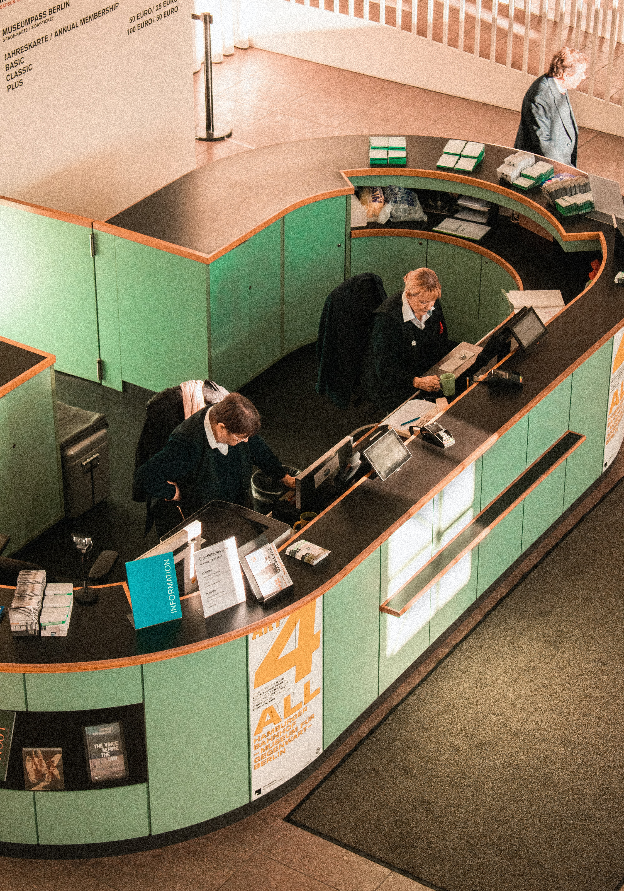
Introduction
Motivation :
As Hotel we will overbook once we know our safe margin.
Objective :
Try to predict the ones who will cancel reservations ?
Goals :
Try to find best algorithm for each hotels and understand the which reservations will be canceled.

Slide 3









Methodology
Data :
Hotel booking demand datasets : Kaggle
119390 Entries
30 Features
Tools :
Data Cleaning : pandas, numpy
Visualizations : matplotlib, seaborn
ML : sklearn, K-fold
Development Environment : jupyter
Roadmap
Data Fetch & Clean (Postgresql -> dataframe )
Eda
Feature Engineering
Model Selection with K-Fold
Optimize

Slide 4
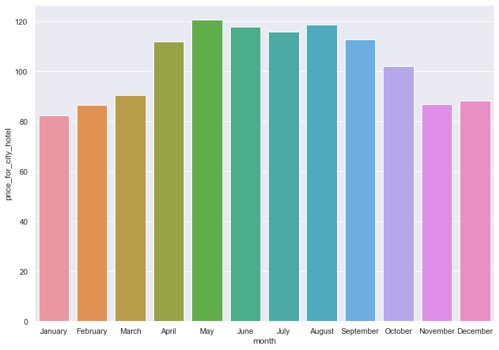
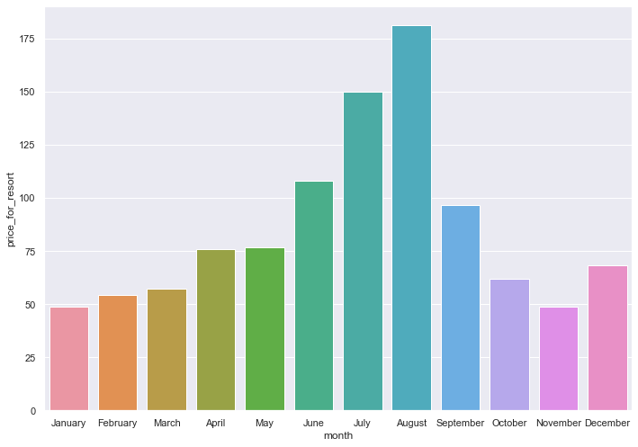
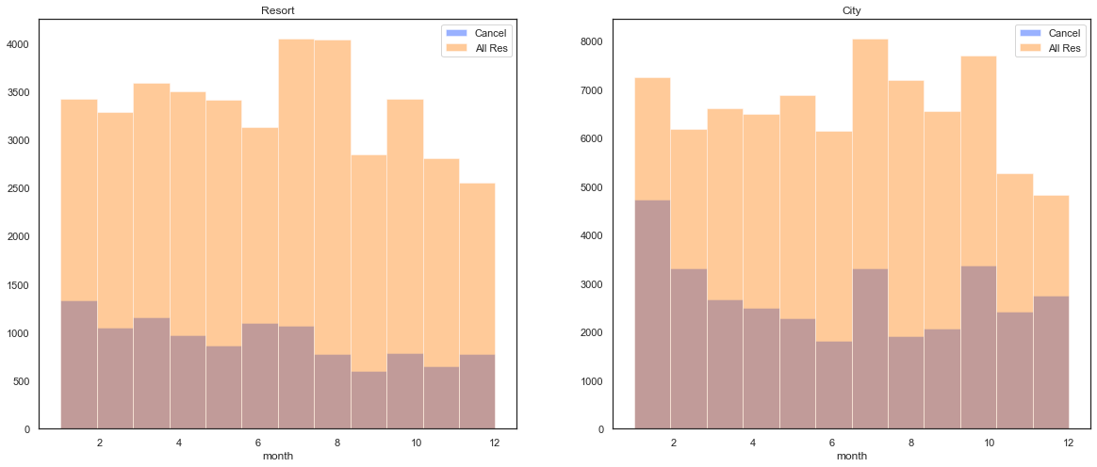
EDA

Slide 5
EDA

Slide 6
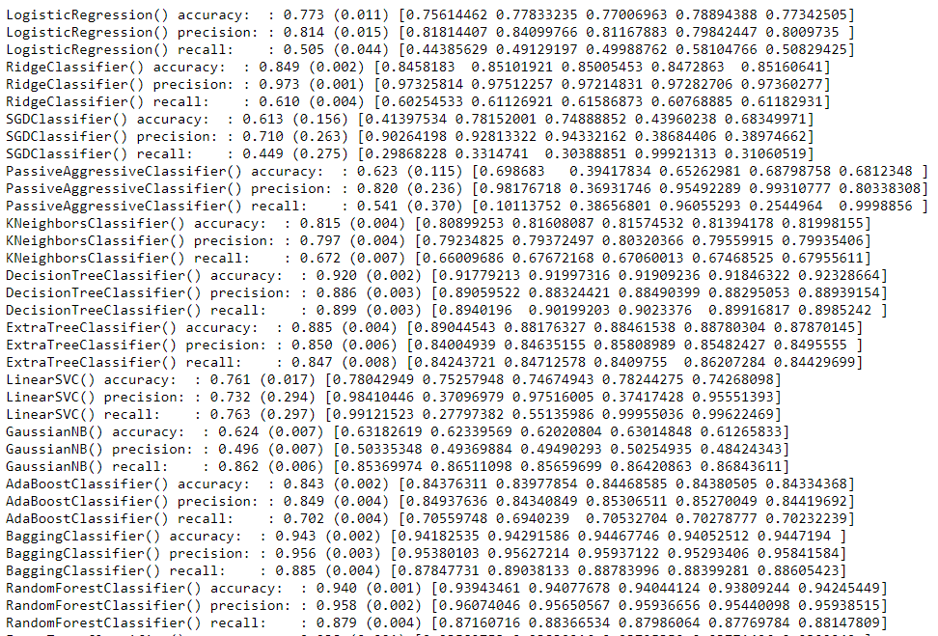
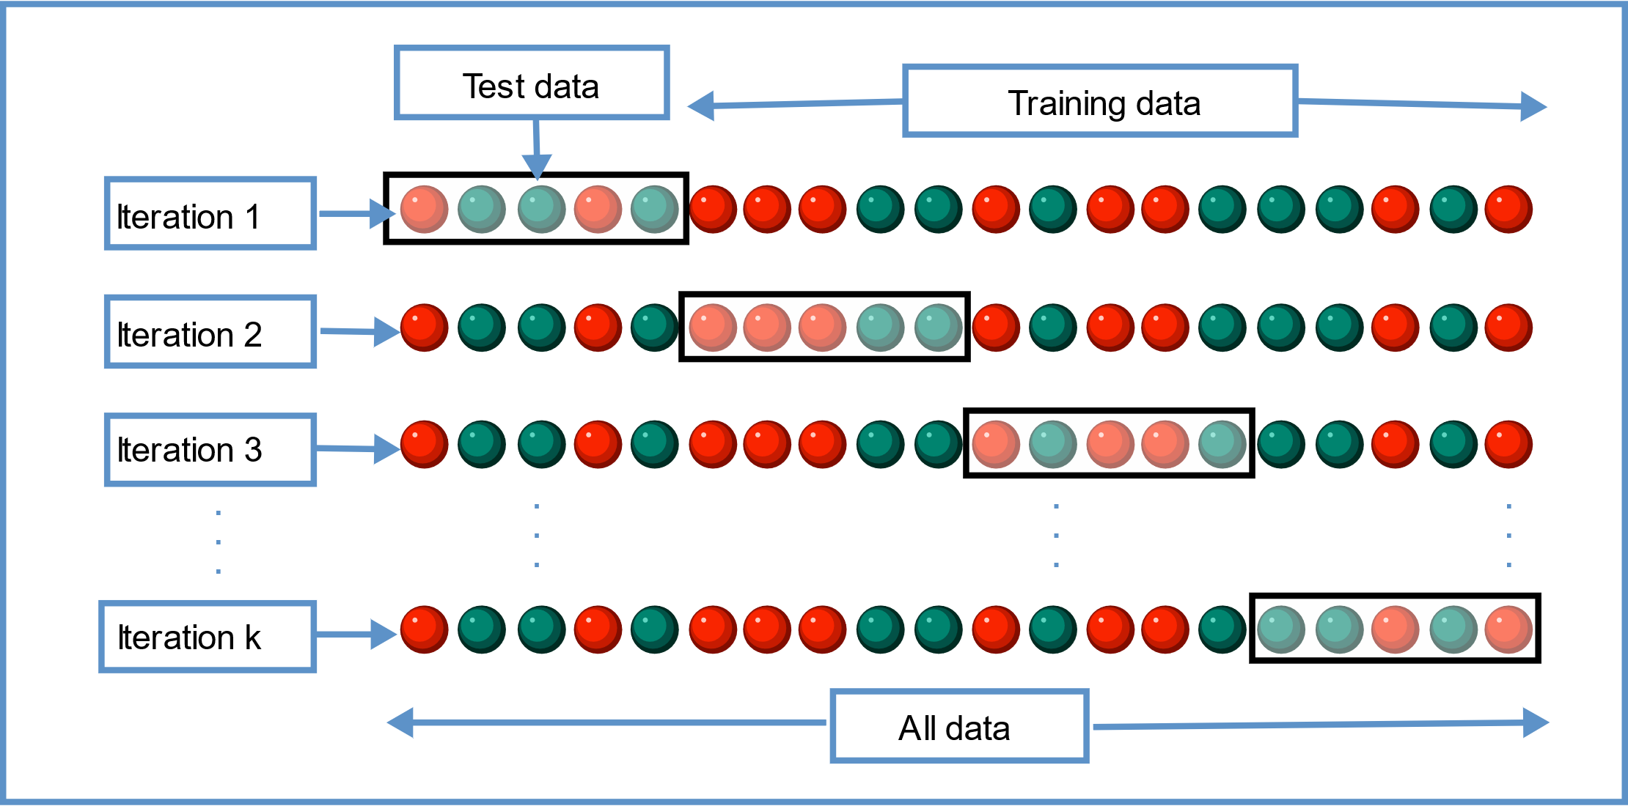
Result

Slide 7
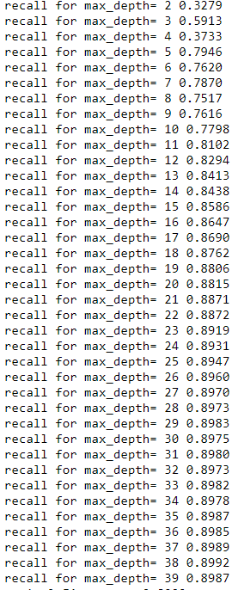

Slide 8
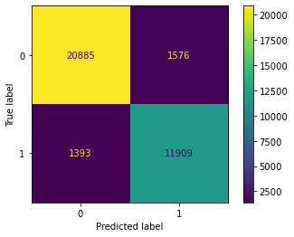
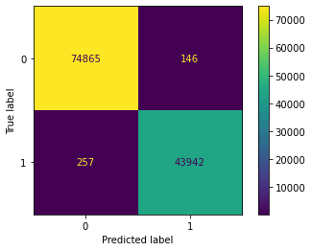
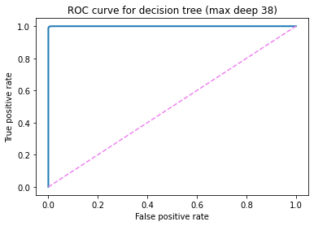
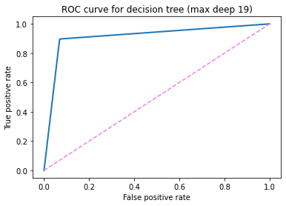
Conclusions

Slide 9
Future Work
A web site with flask that will predict the if the reservation will be canceled or not.
Different models for different sessions.
Different models for different personas ( local vs foreign tourists )

